Slide 1
Space Weather Forecasting ~The Life of a Trainee~
Tori Janus and Jenna Zink

Slide 2
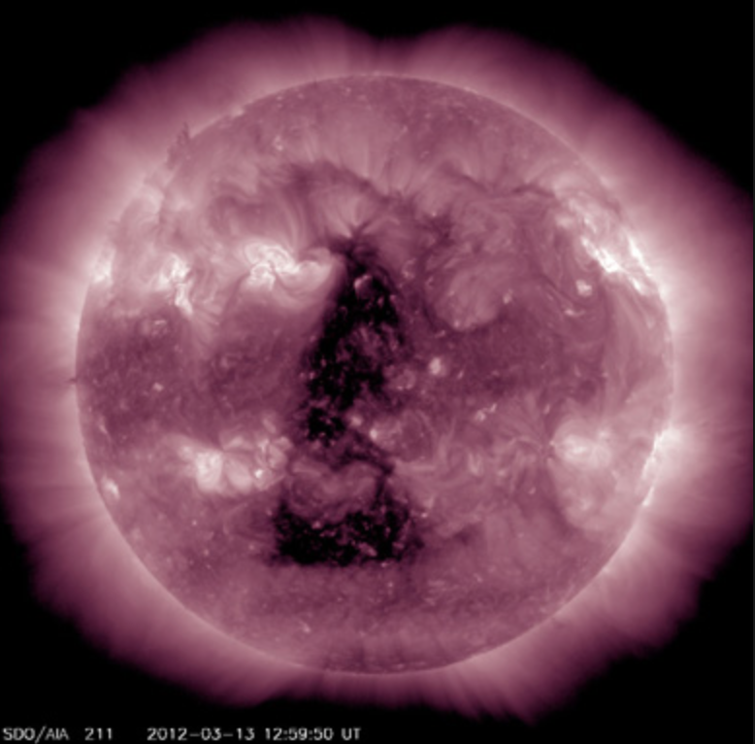
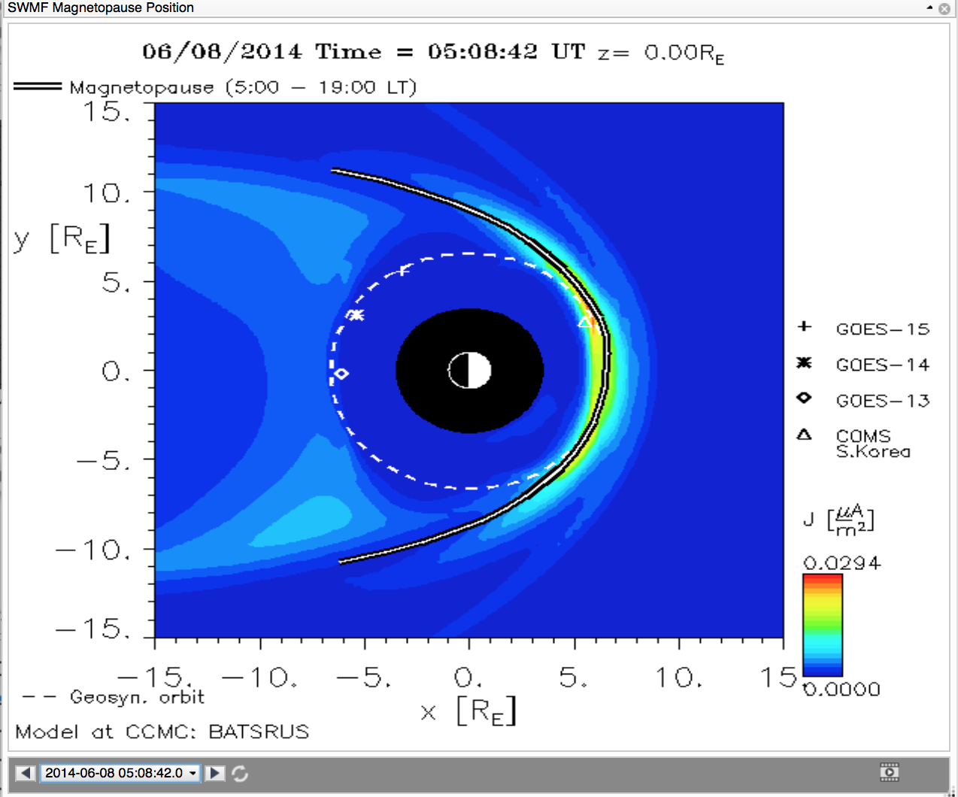
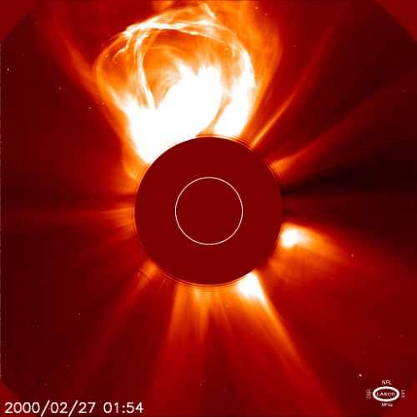
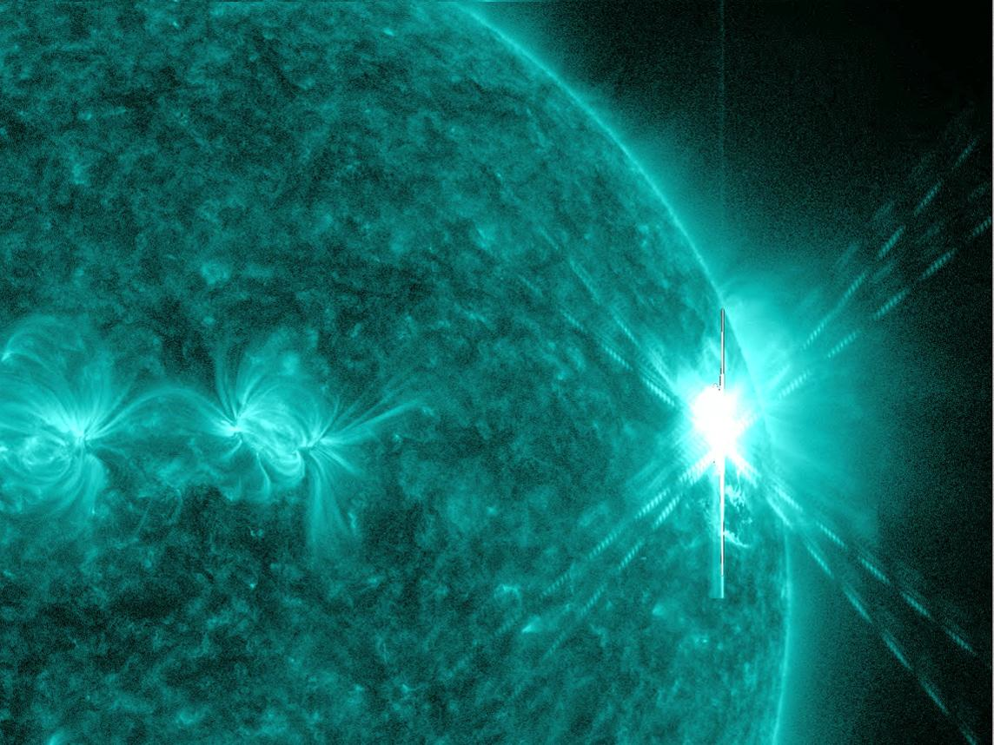
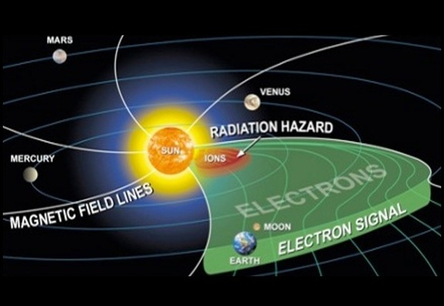
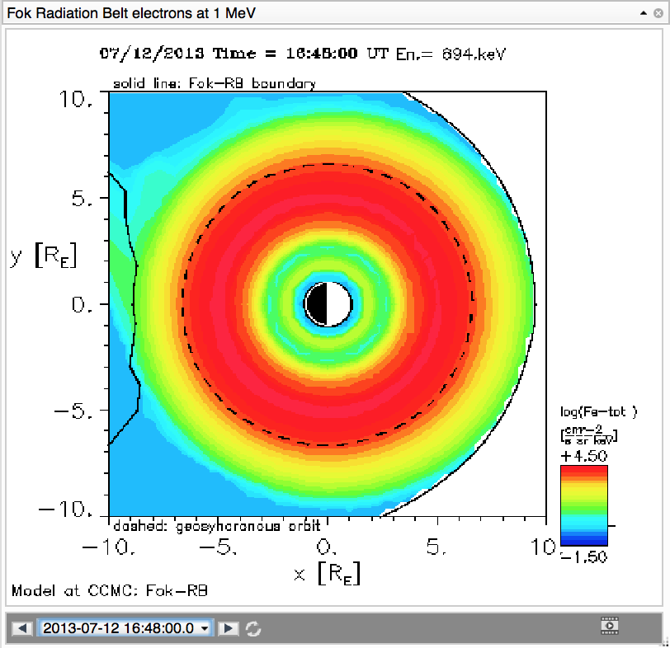
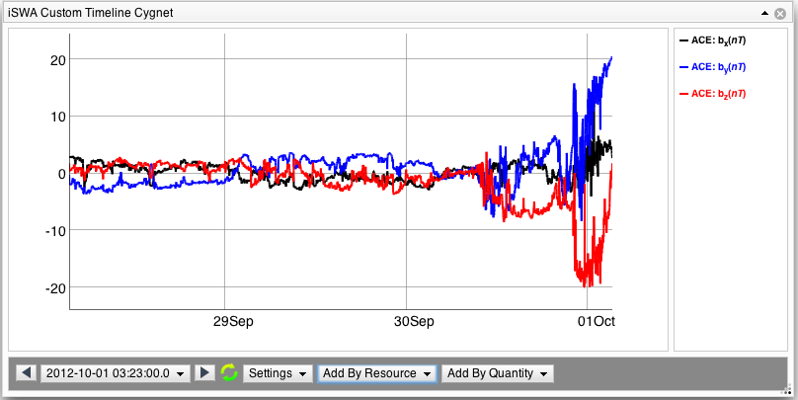
What We Study
Solar Flare
Coronal Mass Ejection
Solar Energetic Particle
Interplanetary Shock
Magnetopause Crossing
Geomagnetic Storm
Radiation Belt Enhancement
High Speed Stream
Notes:
Tori first 4, jenna second 4
Solar flare: burst of energy/brightening/radiation from within a constrained region of the sun
IPS: arrival of a CME or high speed stream at work
Radiation belt enhancement: a change in the flux of electron population

Slide 3
Integrate Space Weather Analysis System
“iSWA is a flexible, turn-key, Web-based dissemination system for NASA-relevant space weather information that combines forecasts based on the most advanced space weather models with concurrent space environment information. iSWA is customer-configurable and adaptable for use as a powerful decision-making tool. The system offers an unprecedented ability to analyze the present and expected future space weather impacts on NASA’s human and robotic missions.”
Notes:
tori

Slide 4
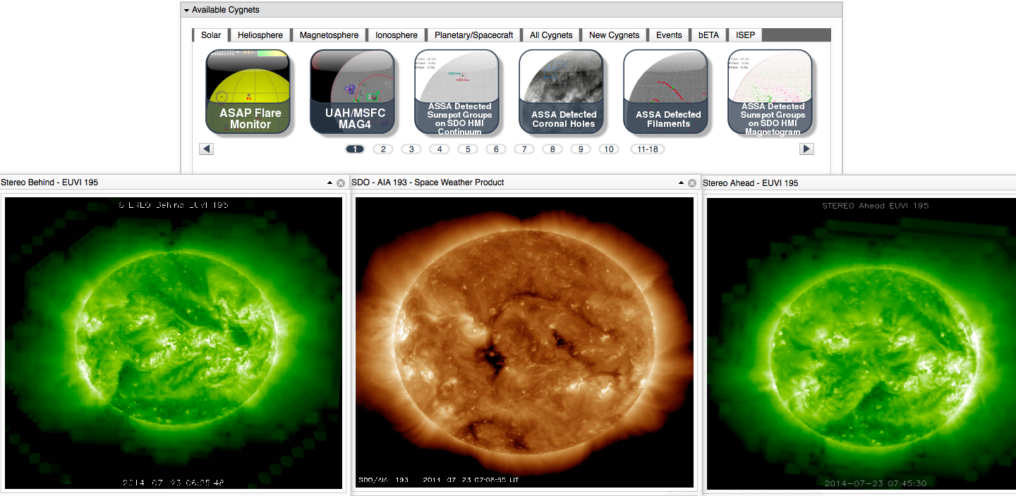
Notes:
tori

Slide 5
StereoCat
CME analysis program developed by Leila Mays and Antti Pulkkinen
Allows us to measure CMEs
The program gives the half-width, velocity, longitude, latitude, and arrival times at 21.5 solar radii
Notes:
jenna

Slide 6
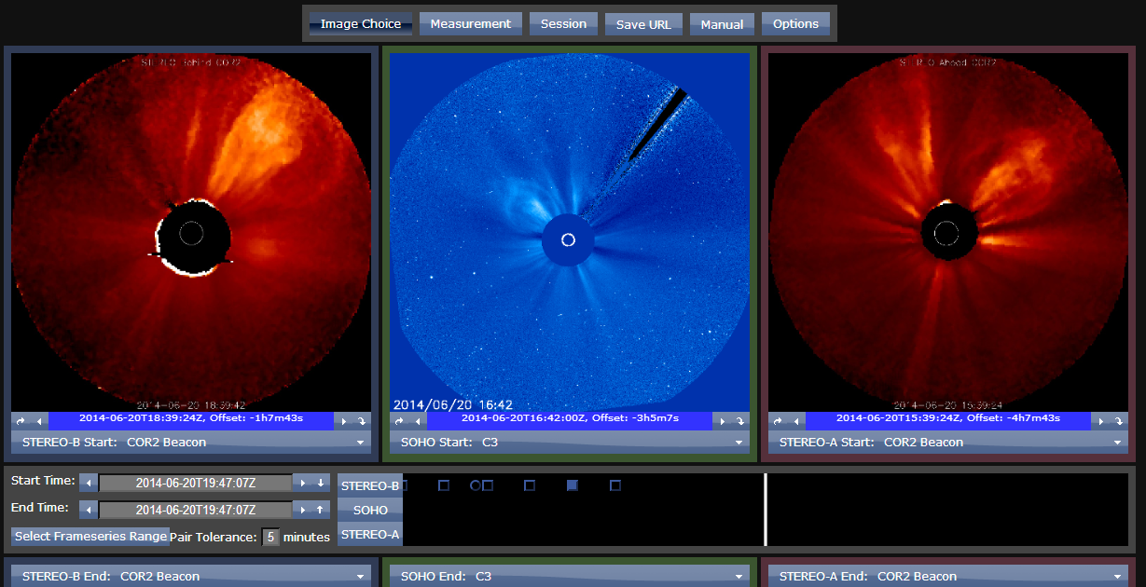
Notes:
jenna

Slide 7
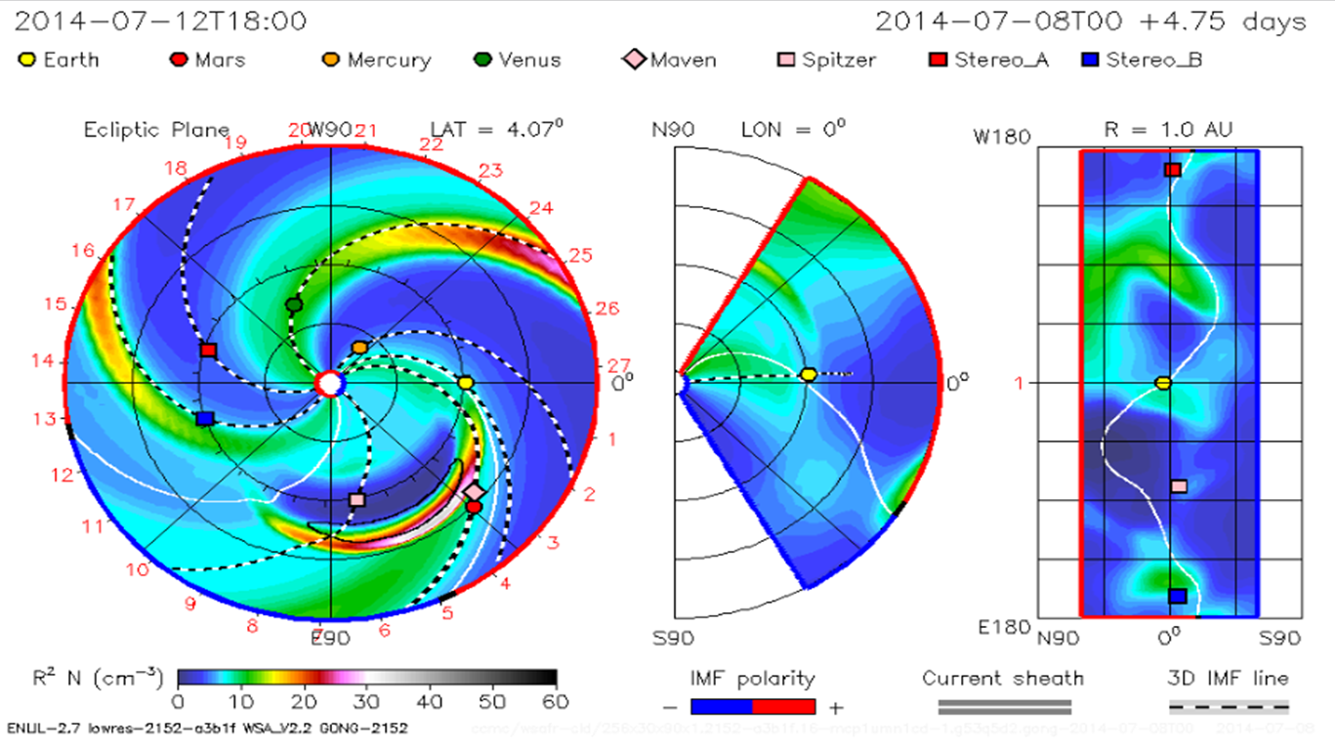
WSA-ENLIL+Cone Model
This is the model that we use in order to predict the trajectory of CMEs!
Notes:
Density and speed

Slide 8
DONKI
Database of Notifications, Knowledge, Information
After thoroughly analyzing a space weather event, we enter the event into DONKI with the proper measurements
Space weather observations
Analysis
Models
Forecasts
Notifications
Notes:
Tori

Slide 9
Notes:
tori

Slide 10
CME that Happened While We Were on Duty ☺
2014-07-08T16:20Z
Notes:
jenna

Slide 11
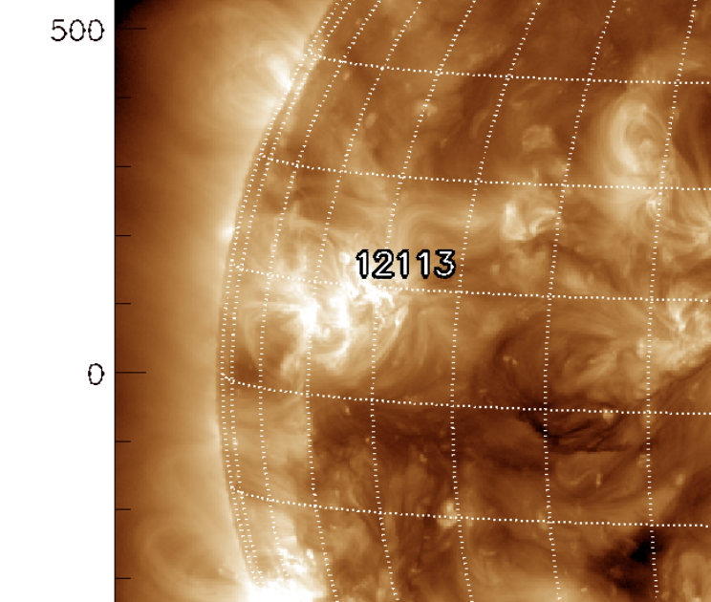
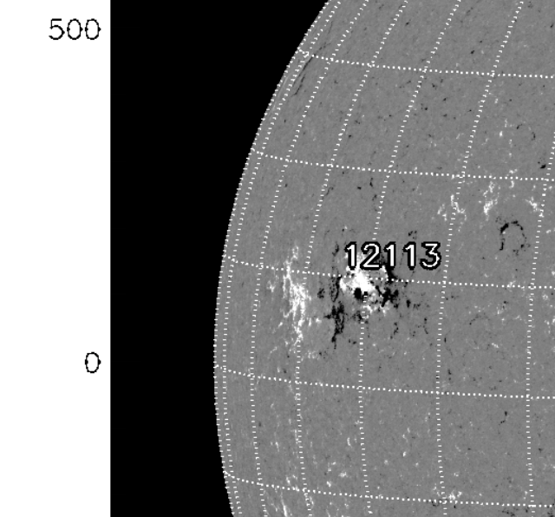
Source Location
Seen in SDO 193
N15E45
AR 2113
Notes:
jenna

Slide 12
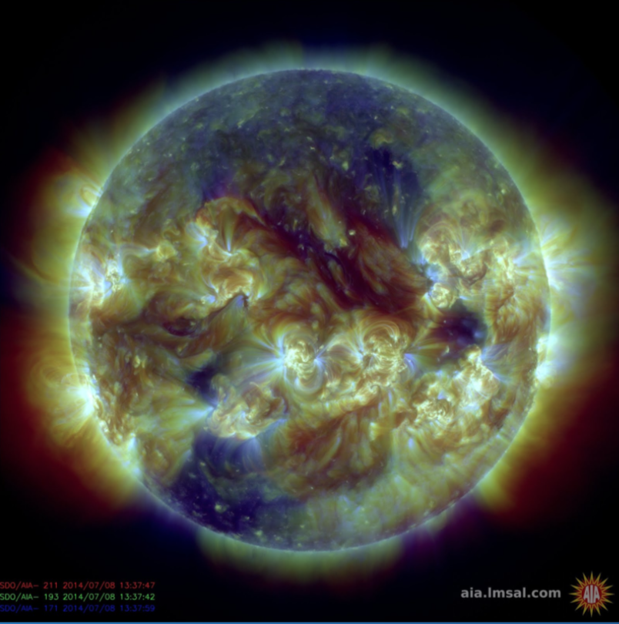
Signatures
Flare
Prominence Material
Dimming
Wave
Rising Loops
Notes:
tori

Slide 13
SDO Video of the Eruption
Notes:
tori

Slide 14
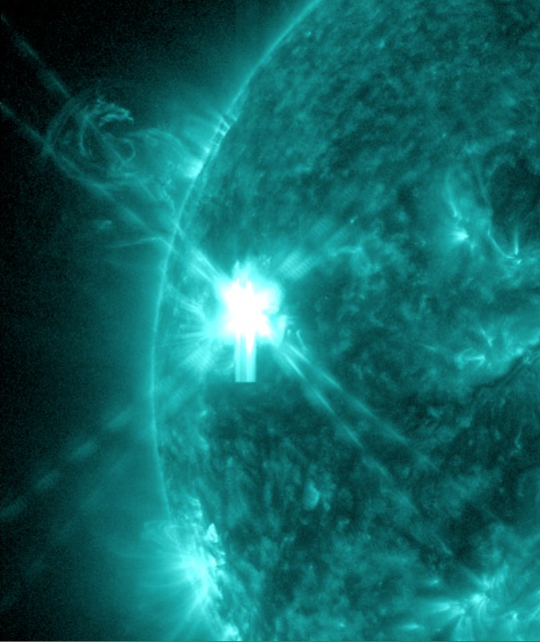
The Dragon Flare
Start Time: 2014-07-08T16:08Z
Peak Time: 2014-07-08T16:20Z
End Time: 2014-07-08T16:30Z
M6.5 Class
Notes:
jenna

Slide 15
The Coronal Mass Ejection
Start Time: 2014-07-08T16:54Z
Type: C type
Half-width: 49 degrees
Speed: 725 km/s
Longitude: -67 degrees
Latitude: 34 degrees
Passes 21.5 Rs at: 2014-07-08T20:31Z
Notes:
tori

Slide 16
WSA-ENLIL+Cone Model

Slide 17
The Notification
Notes:
jenna

Slide 18
The Videos! (Thanks Barbara)

Slide 20
Bai Hatazzzz

Slide 22
Future Plans
Forecasting into the upcoming school year
Jenna is working with Dr. Rebekah Evans on CME Deflection
They are currently working on getting published
They are attending the AGU fall meeting in December in San Francisco, California!
Tori is continuing her studies with the career goal of becoming a Dentist
She is going to Honduras with UMD’s branch of the Global Dental Brigades to work with children

